Slide 1











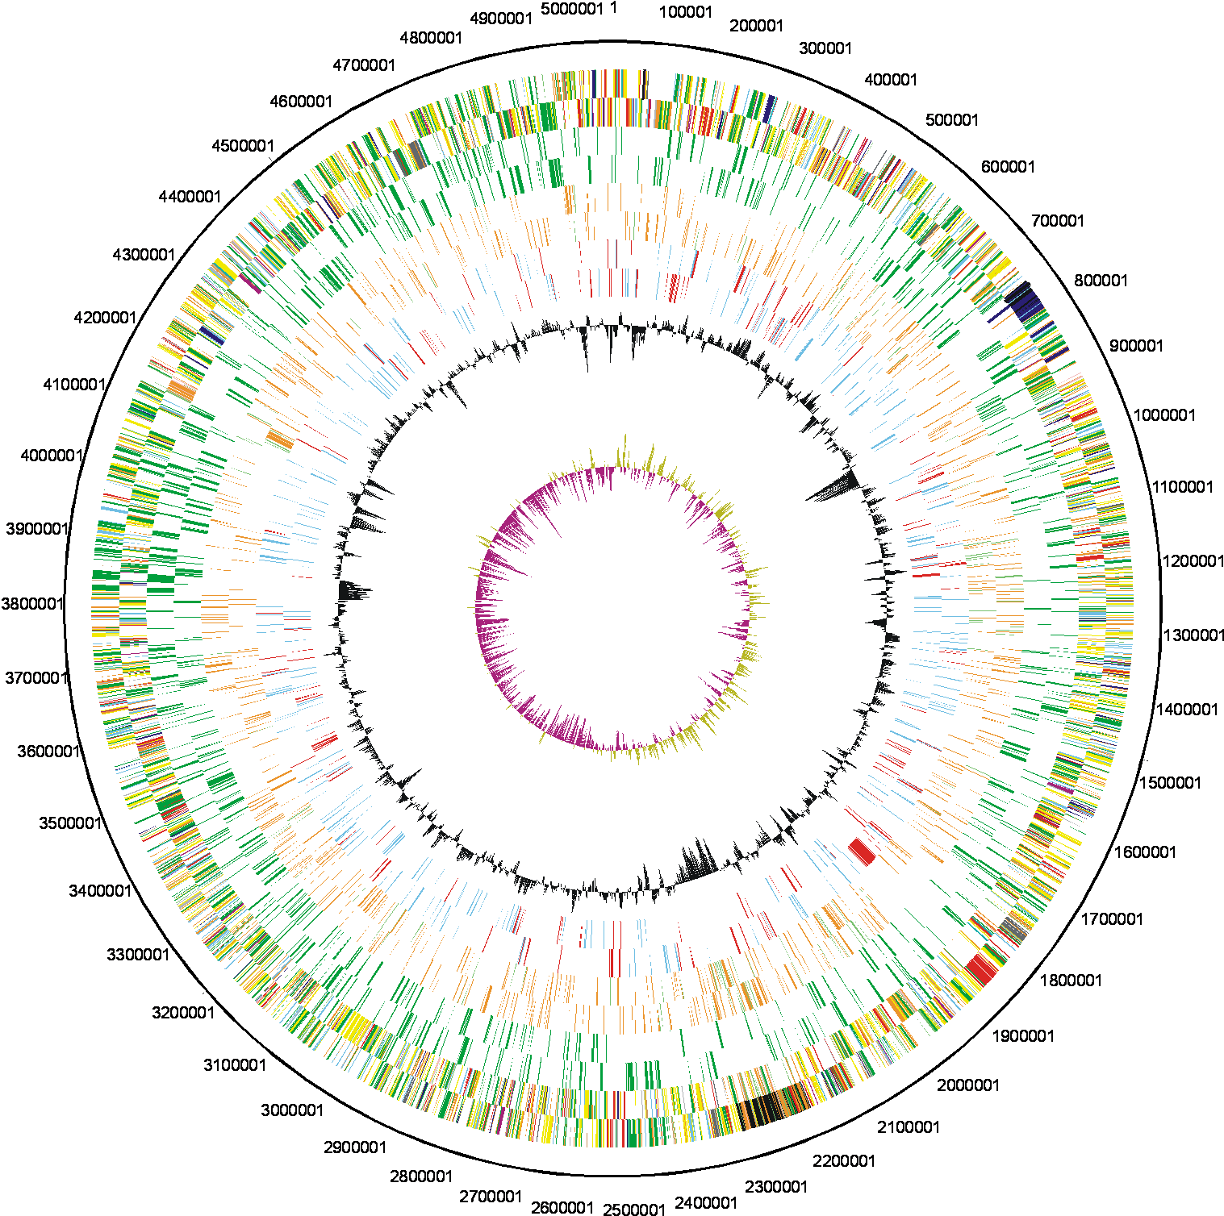




Lee Katz
Centers for Disease Control and Prevention
404-639-3875
gzu2@cdc.gov
Kraken with Kalamari: Contamination Detection
Saturday
Poster number 1080
Lee S. Katz^{1,2}, Taylor Griswold¹, Rebecca Lindsey¹, Ana Lauer¹, Monica S. Im¹, Grant Williams¹, Jessica L. Halpin¹, Gerardo A. Gómez¹, Katie Roache¹, Zuzana Kucerova¹, Cheryl L. Tarr¹, Andrew Page³, Henk den Bakker², and Heather A. Carleton¹
¹ Enteric Diseases Laboratory Branch, Centers for Disease Control and Prevention, Atlanta, Georgia, USA; ² Center for Food Safety, College of Agricultural and Environmental Sciences, University of Georgia, Griffin, Georgia, USA;
³ Quadram Institute, Norwich Research Park, Norwich, UK, NR4 7UA
ABSTRACT
Background
Many laboratories use metagenomics profilers such as Kraken to detect contamination in individual bacterial genomes as part of foodborne disease surveillance activities. If results are found that are inconsistent with the target taxon, then contaminated sequence data may be present. The standard Kraken database is based on RefSeq which may have contaminated, misidentified, or atypical genomes. Additionally, the underlying taxonomy, taken from the NCBI taxonomy website, may be conflicting or incomplete.
Methods
To address these issues we created Kalamari, a database for quantifying potential contamination. Kalamari contains genome assemblies curated by subject matter experts, and closed with PacBio sequencing. Kalamari was comprehensively populated by more than 250 genomes of species and subspecies chosen to be phylogenetically representative of agents tracked by genome-based foodborne disease surveillance, common contaminants, and diverse phyla and bacterial genera. Furthermore, the taxonomy has been edited to reflect the known phylogeny of many foodborne bacteria. For example, the four lineages of Listeria monocytogenes are defined, and the Shigella genus has been reclassified as a subspecies of E. coli.
Results
We were able to assign more reads to the correct genus as follows when comparing the standard database vs the Kalamari database: Listeria, 88% to 95%; Salmonella, 90% to 90%; Escherichia, 56% to 91%; and Campylobacter, 73% to 95%. Additionally, we were able to decrease the number of unclassified reads as follows: Listeria, 11% to 4%; Salmonella, 5% to 5%; Escherichia, 5% to 4%; and Campylobacter 26% to 5%.
Conclusion
For four major foodborne bacterial genera, our results showed more sensitivity and less uncertainty with the Kalamari database than the standard database. Therefore, Kalamari may allow for improved screening of foodborne bacterial genomic sequences for potential contamination.
KALAMARI BRINGS FLAVORFUL RESULTS
We sequenced 170 genomes from 7 genera with the Illumina MiSeq (A). These raw reads were analyzed with Kraken v0.10.4 using either the standard Kraken database (downloaded July 23, 2014) or Kalamari v2. Some reads could not be classified and are shown in B. The percentages of reads matching with the target genus are shown in C, and the percentages of reads matching with the target species are shown in D.
A. Genome assemblies from various species were used to test Kalamari
B. Reads that could not be classified using Kraken
Genus tested | species tested | n
Campylobacter | coli | 4
 | fetus | 3
 | helveticus | 3
 | hyointestinalis | 3
 | jejuni | 4
 | lari | 3
 | upsaliensis | 3
Cronobacter | dublinensis | 2
 | malonaticus | 2
 | sakazakii | 2
 | universalis | 2
Escherichia | albertii | 3
 | coli | 9
 | fergusonii | 3
Salmonella | bongori | 3
 | enterica | 69
Genus tested | species tested | n
Listeria | grayi | 1
 | innocua | 3
 | ivanovii | 5
 | marthii | 1
 | monocytogenes | 6
 | murrayi | 1
 | seeligeri | 3
 | welshimeri | 8
Vibrio | cholerae | 3
 | parahaemolyticus | 3
 | vulnificus | 3
Yersinia | enterocolitica | 3
 | pestis | 3
 | pseudoturberculosis | 3
THE KALAMARI RECIPE
Identify similar plasmids; copy taxonomy ID to similar plasmids. ANI > 97%
C. Reads matching the target genus
D. Reads matching the target species
Set of plasmids
tax 562
Tax
590
Tax
666
Set of Reference genomes;
taxonomy
tax 562
Tax
590
Tax
666
tax 590
Tax
562
Serve hot!
Separate plasmids from bacterial genomes. Apply species or subspecies taxonomy IDs
Publication on model organisms (Galperin 2008)
Result: a set of assemblies associated with specific taxonomy IDs
Set of chromosomes
Add in plant and animal mitochondrial genomes. Remove chromosomes similar to others with ANI >97%
FOOD FOR THOUGHT
The methods and results describe a version of Kalamari from early 2018 (version 2). We have thoughtfully constructed a recipe for Kalamari v2, and we show modest although slight improvements over the standard Kraken database.
The latest version of Kalamari will incorporate several improvements. Only one genome assembly per taxon will be included within the database. Additionally, certain species are defined solely by their plasmids and will be treated specially. These species include Shigella species, Bacillus anthracis, and Yersinia pestis. The underlying taxonomy will be partially redefined with the guidance of subject matter experts. Next, some genome assemblies might not be the best representations of their taxa, and so we will remove these in favor of better representatives. Lastly, because many of these isolates come from hosts or food sources, we have included the mitochondrial genomes of 13 different eukaryotes, including squid, to help mark host contamination.
REFERENCES
Jain, Chirag, et al. "A Fast Adaptive Algorithm for Computing Whole-Genome Homology Maps." bioRxiv (2018): 259986.
Galperin, Michael Y. "Genomes of model organisms: know thy tools." Environmental microbiology 10.6 (2008): 1383-1391.
Pruitt, Kim D., et al. "NCBI Reference Sequences (RefSeq): current status, new features and genome annotation policy." Nucleic acids research 40.D1 (2011): D130-D135.
Wood, Derrick E., and Steven L. Salzberg. "Kraken: ultrafast metagenomic sequence classification using exact alignments." Genome biology 15.3 (2014): R46.
ACKNOWLEDGEMENTS
This work was made possible through support from the Advanced Molecular Detection (AMD) Initiative at the Centers for Disease Control and Prevention. Some icons are supplied by the Noun Project, specifically from Yazmin Alanis, Georgiana Ionescu, Dinosoft Labs, and Maxim Kulikov.
Genomes sequenced in-house
Type strain genomes sequenced from the NCTC 3000 collection
KALAMARI TO GO
Kalamari is defined as the database of genomes with their associated taxonomy IDs. When used with Kraken, shared genomic loci are associated with the last common ancestor in the taxonomy. For example, a genomic island that is found in both Listeria monocytogenes and Listeria innocua will instead be associated with Listeria and not any specific Listeria species.
However, Kalamari can be readily used to build an index for the taxonomic multipurpose tool bigs_id, or for taxonomic screening with Mash. Many other multipurpose tools exist, e.g., MetaPhlAn, that require a set of well-curated genome assemblies and that could conceivably benefit from the Kalamari project.
Kalamari can also be used as a set of reference genomes for a species-identification algorithm. Generally, average nucleotide identity (ANI) is used. However other quick-comparison tools like Mash can be used too.
Division for Foodborne, Waterborne, and Environmental Diseases

